Slide 1


PRINT-N-GRIP: A DISPOSABLE, COMPLIANT,
SCALABLE AND ONE-SHOT 3D-PRINTED
MULTI-FINGERED ROBOTIC HAND
Alon Laron
Supervisor: Dr. Avishai Sintov
School of Mechanical Engineering, Tel-Aviv University

Slide 2

Talk Outline
Introduction
  Motivation
  PNG hand
Design and production
  Finger
  Universal base
Finger model
  Model development
  Verification
Experiments
  Max load
  Grasping ability
  Mechanical characteristics
Conclusions
Future work

Slide 3

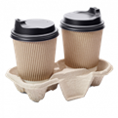
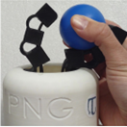
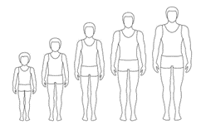
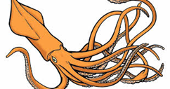
Introduction
Print-N-Grip (PNG) hand
ONE-SHOT 3D-PRINTED
DISPOSABLE
COMPLIANT
SCALABLE
MULTI-FINGERED ROBOTIC HAND
*The work in this thesis was submitted to the Journal of Mechanical Design and is currently in the second round of review.
*This work was submitted by Ramot as a PCT (International) patent application, patent currently pending.

Slide 4

Motivation
Robots, and in particular robotic hands and grippers, have always been the ideal solution for replacing human workers in hazardous environments.

Slide 5
Motivation
However, several factors limit this solution and make it difficult to integrate:
  Highly expensive
  Reuse is limited due to contamination
  Humidity, chemicals, and radiation can damage electronic components
  Assembly and initialization of the existing systems requires expertise
  Other solutions shows limited ability to conduct complex tasks

Slide 6
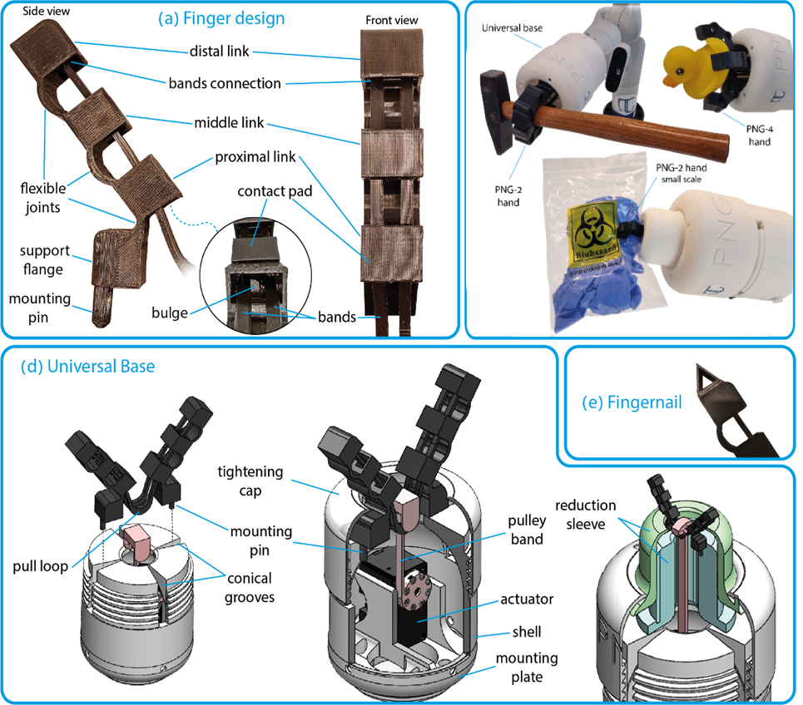
Print-N-Grip (PNG) Hand
PNG hand is a one-shot 3D printed tendon-based underactuated mechanism able to adapt to the shape of grasped objects.
  Accommodate a variable number of fingers, as desired by the practitioner.
  Due to its low cost, the PNG hand can be disposable upon contamination.
  The device's simple design facilitates easy detachment and reassembly.

Slide 7
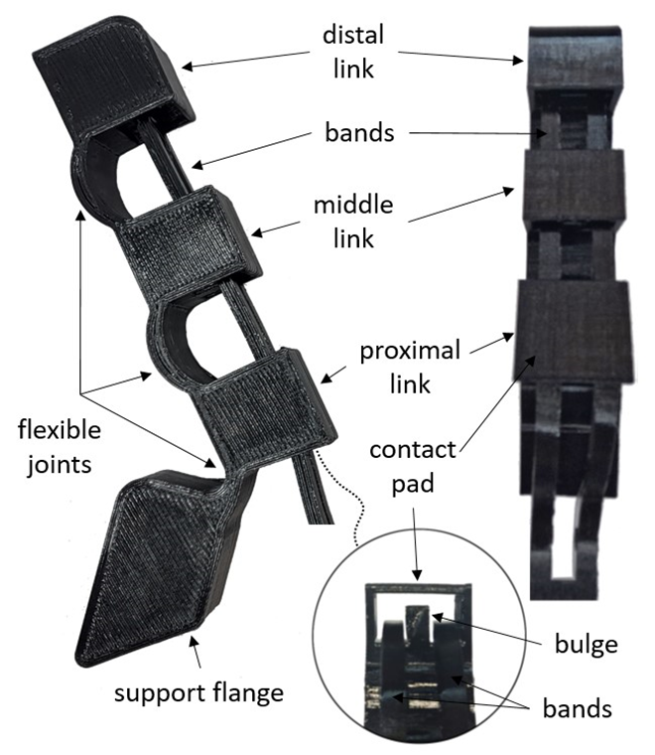
Finger Design
The finger design of the PNG hand is inspired by existing robotic hands like Yale OpenHand project but eliminates the need for assembly and additional tendons thredening , printing all in one unit instead.
Each finger includes four links, connected by a flexible joints.
Dual band tendons running along the finger, separated by a bulge.

Slide 8
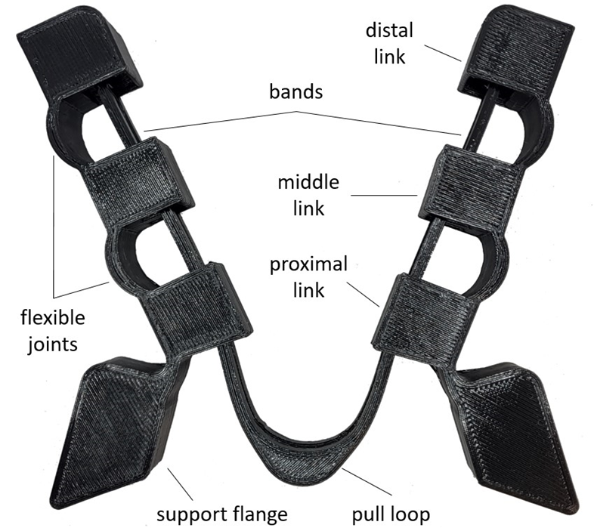
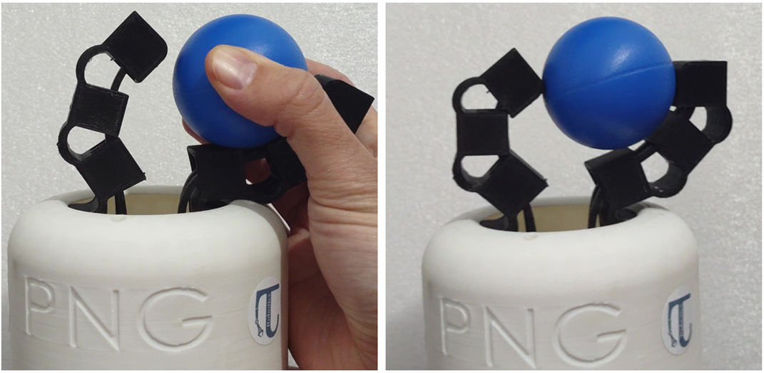
Finger Design Additional Features
differential

Slide 9
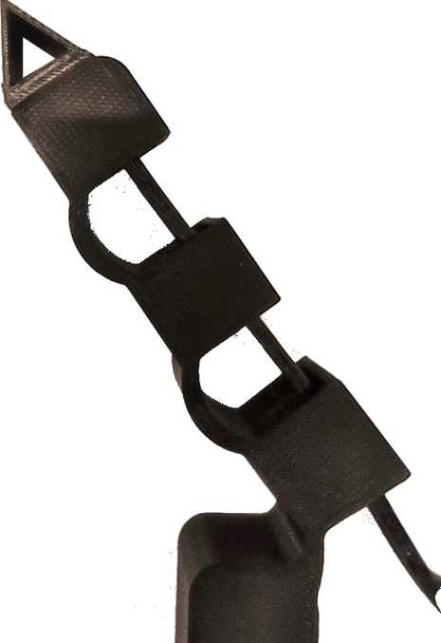
Finger Design Additional Features
Fingernail + add-ons

Slide 10
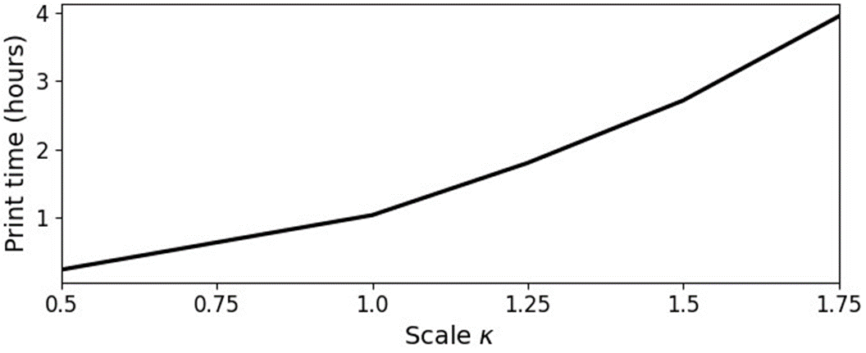
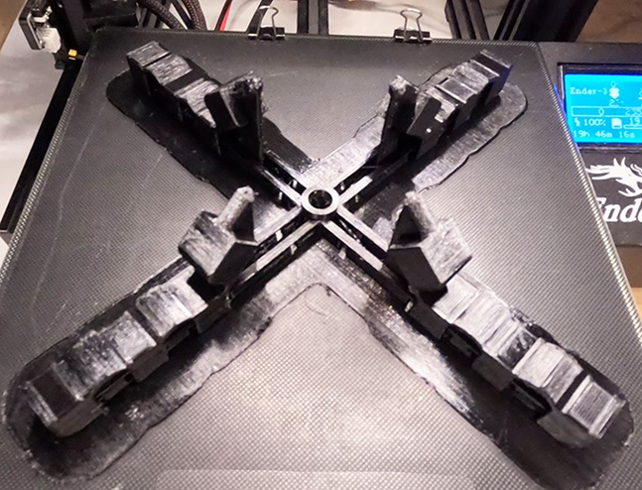
Manufacturing Process

Slide 11
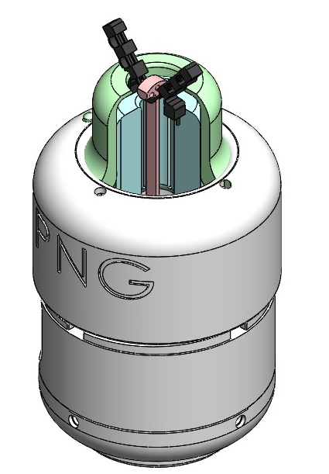
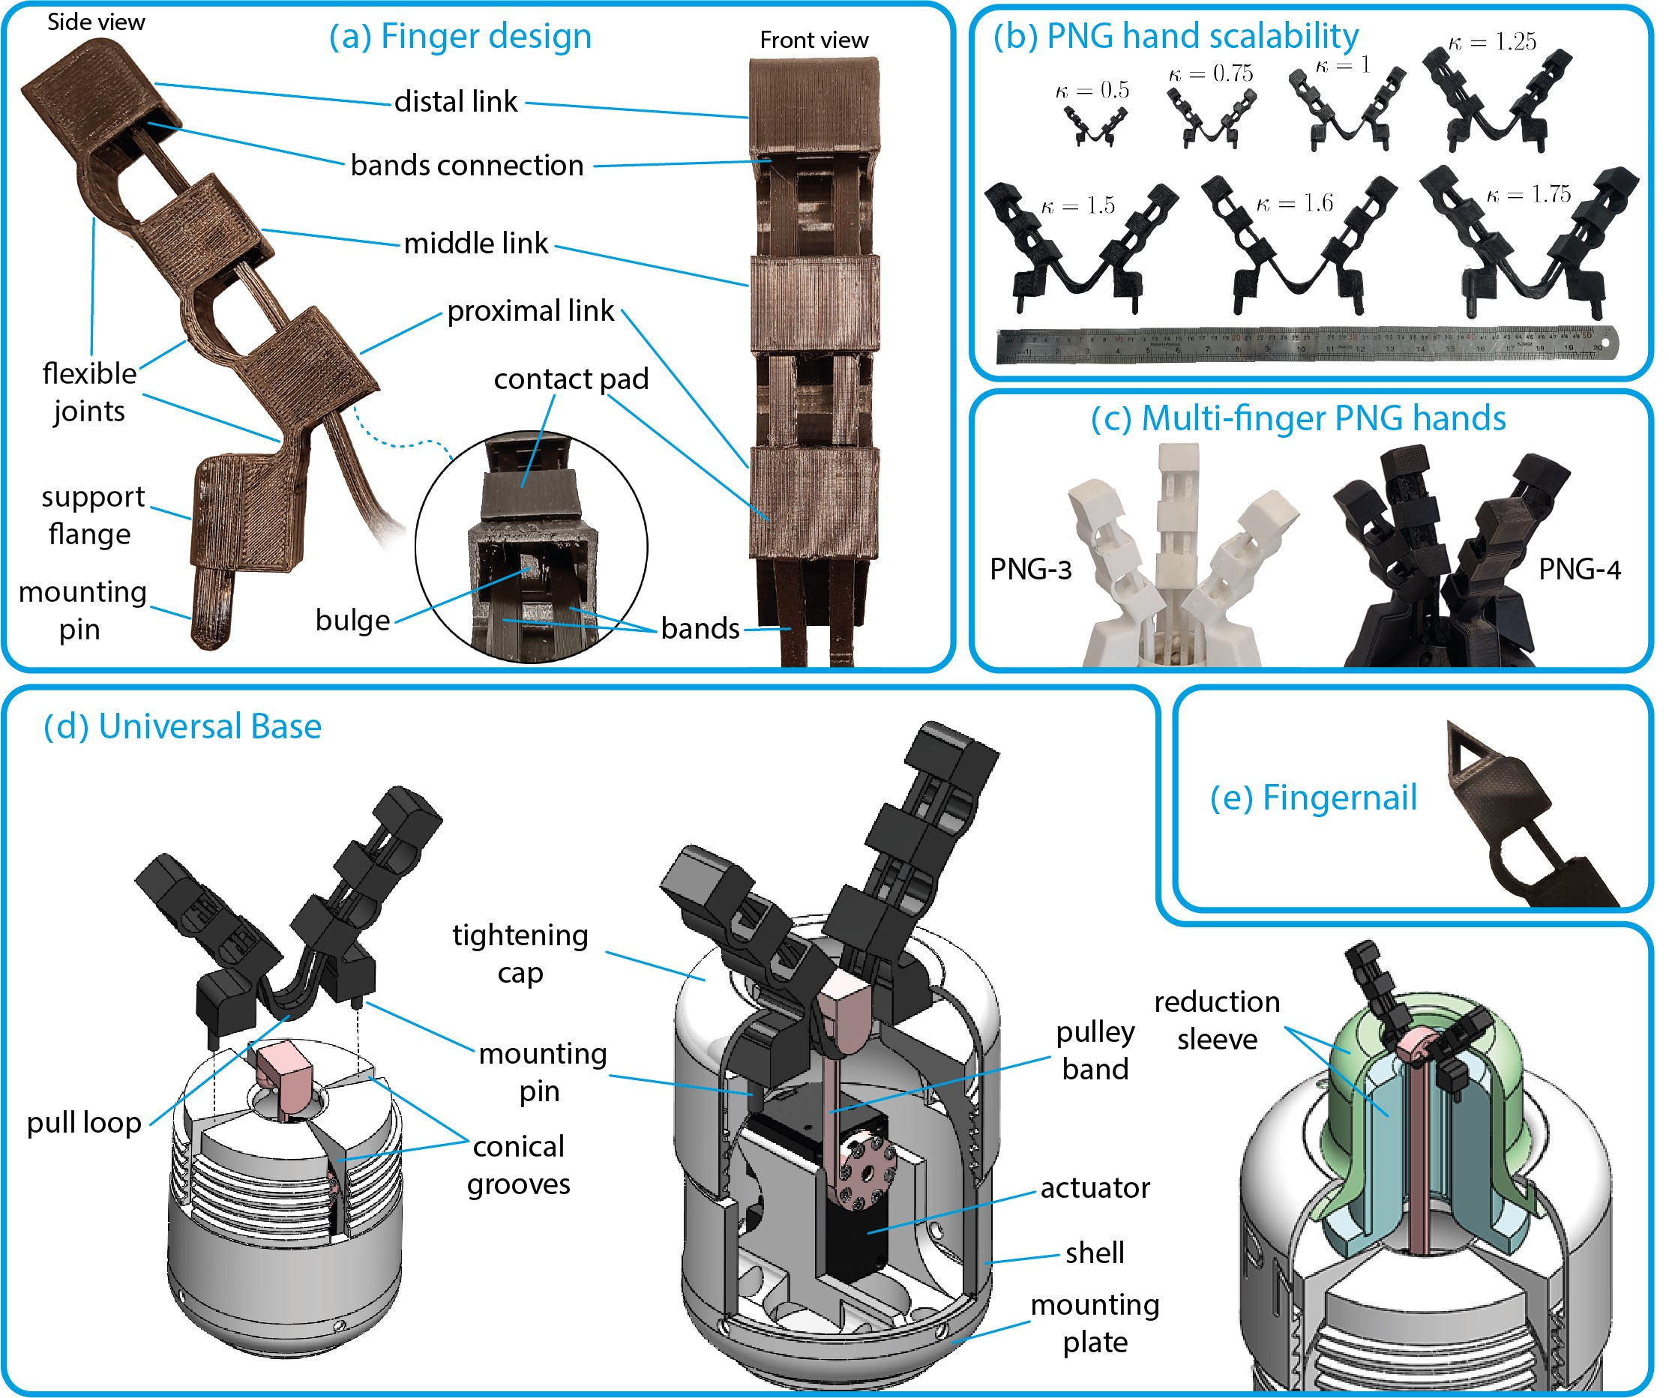
Universal Base
Tightening cap
shell
Arm connector

Slide 12
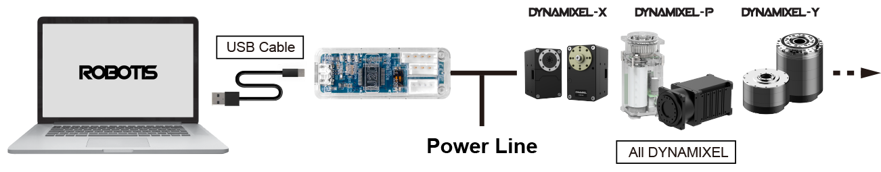
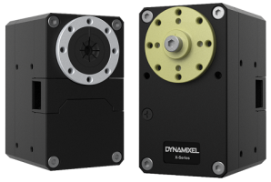
Coding and Communication
Software control
Yale OPENHAND based
Python
ROS Kinetic
Create another model
Solid ground
U2D2 - Communication converter
Compact and efficient
Cost effective.
Community
ROBOTIS compatible
Dynamixel XH540
Reliable
Precise
Performance
Users community
Built-in feedback

Slide 13
Yale OPENHAND
Yale
Contain the control repositories for existing designs. The main body of the code is formulated for simple implementation in ROS Kinetic.
PNG
New hand model was written suitable for my design, including:
Model PNG control
Communication adjustments
Main user file
Torque converter

Slide 14
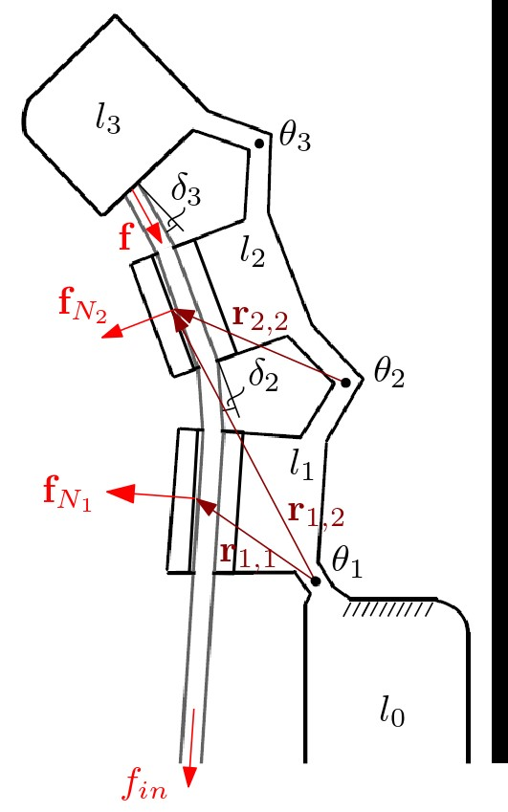
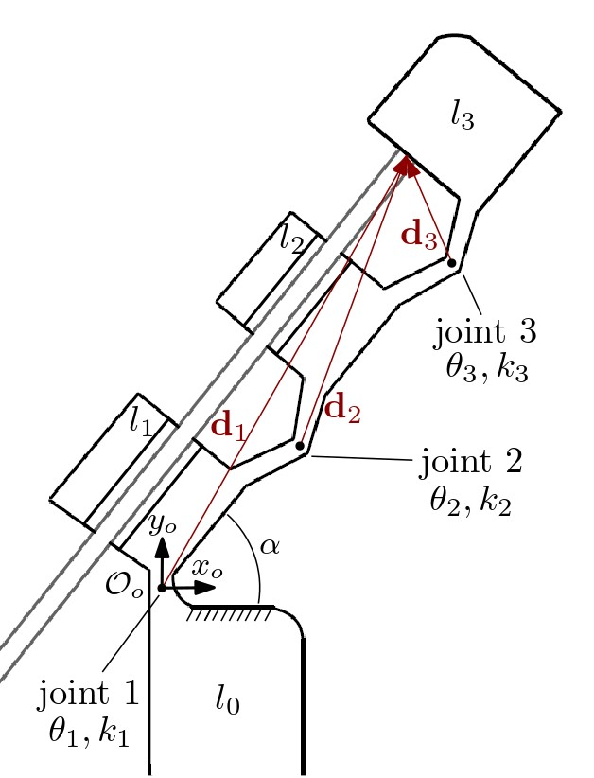
Finger Model
Due to the elasticity of the finger, the flexible joints can be considered as conventional joints with springs.
Hence, the system is analysed as a kinematic chain of rigid links connected by rotational joints with springs.
Assumptions:
  Friction is neglectable.
  Quasi-static motions where dynamic effects and damping can be neglected.
  Joint angles θ2 ...θm are equal to zero when no load is exerted .

Slide 15

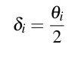

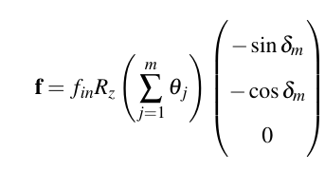

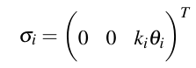
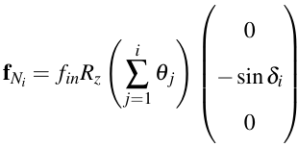

Finger Model
Equations:
Force analysis on joint:

Slide 16
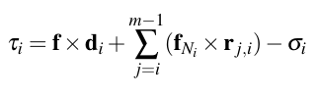


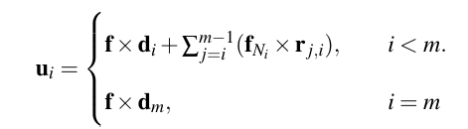
Finger Model
Equations:

Slide 17
Neural network assistance
Challenge:
Initial comparisons revealed significant errors.
Cause:
Motors torque information was not accurate enough.
Solution:
Experiment - measuring torque outputs for given numeric inputs
Leveraged this experimental data to train a basic neural network
Predict accurate torque values, significantly improving precision

Slide 18
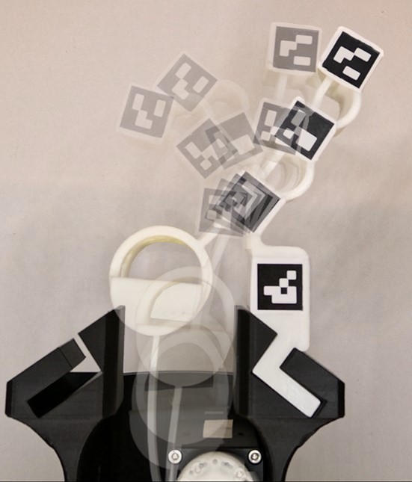
Model Verification Experiment Setup

Slide 19
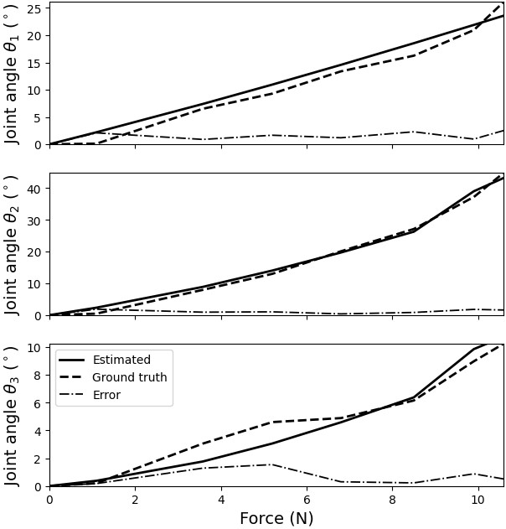
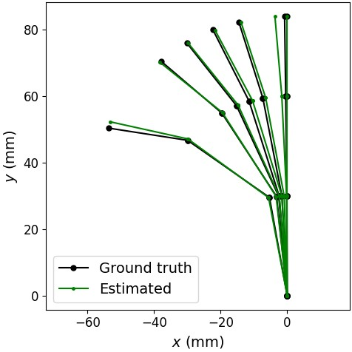
Model Results
- The mean angle error over all finger configurations in the data is 1.04◦ ±0.74◦.
- A slightly large error can be seen at the early beginning of the θ1 motion due to some errors among them the unmodeled tightening phase of the band from a loose state.

Slide 20
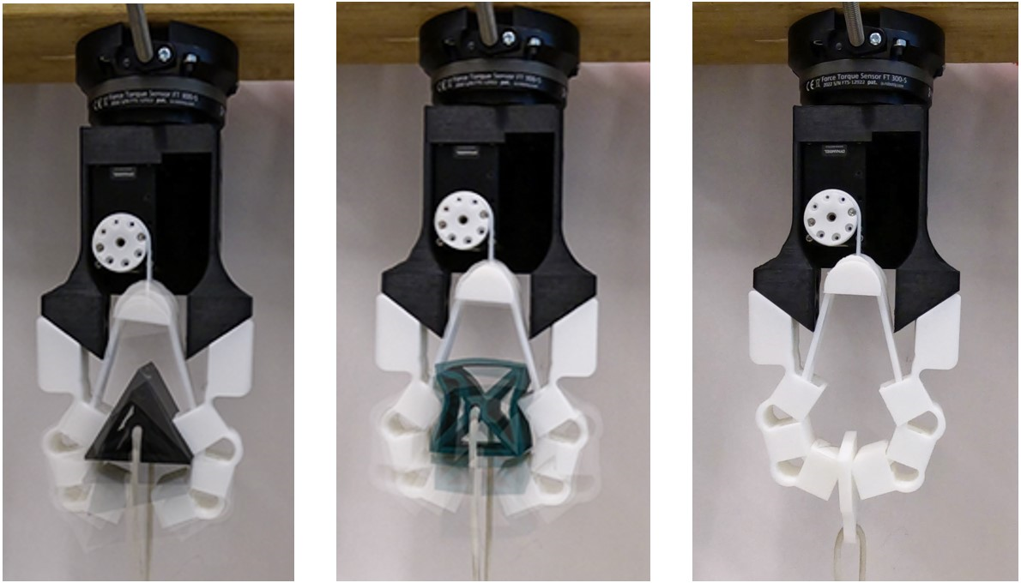
Max Load Testing Setup
Tow base material of gripper:
  TPU-95A
  TPU-85A
Four grasped shapes:
  Cylinder
  Cuboid
  Triangular prism
  Thin sheet (to pinch)
Tow types of grasped shapes :
  Rigid
  Flexible
*Each set of objects matches the size of its corresponding tested gripper

Slide 21
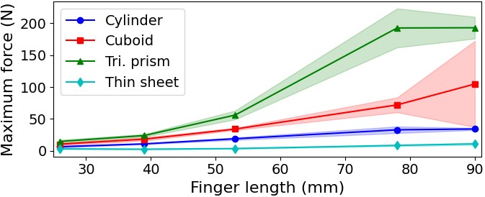
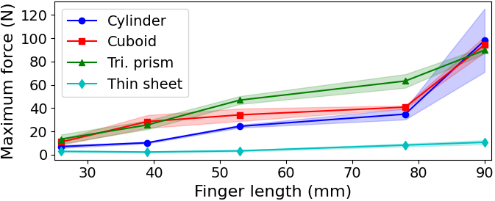
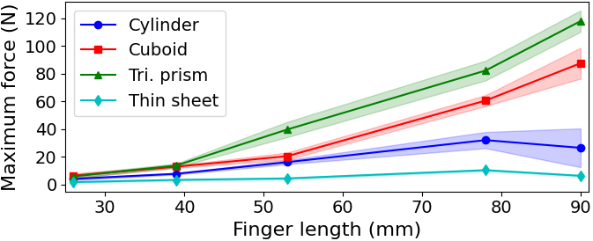
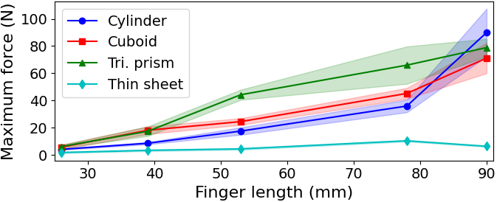
Max Load Testing Setup
FLEXIBLE OBJECTS | RIGID OBJECTS | TPU
 |  | 95A
 |  | 85A

Slide 22
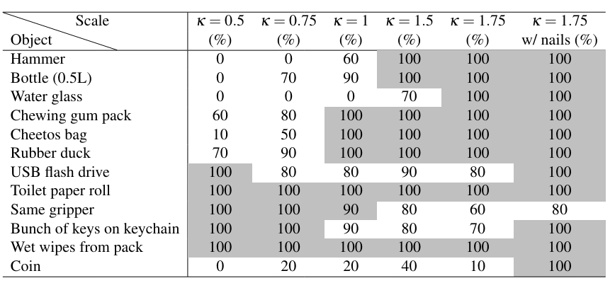
Grasping Experiments

Slide 23
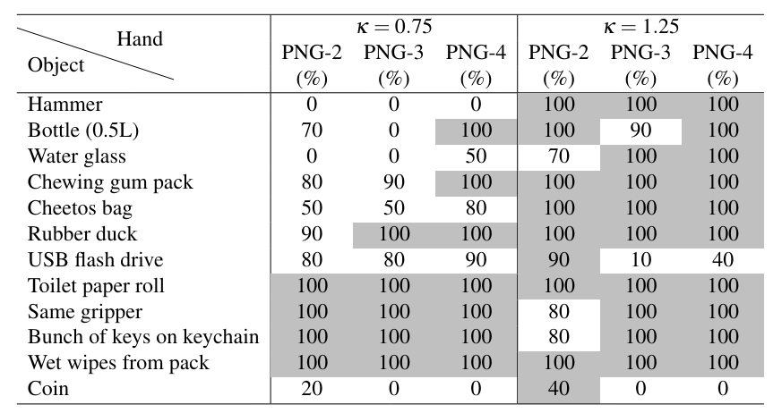
Grasping Experiments

Slide 24
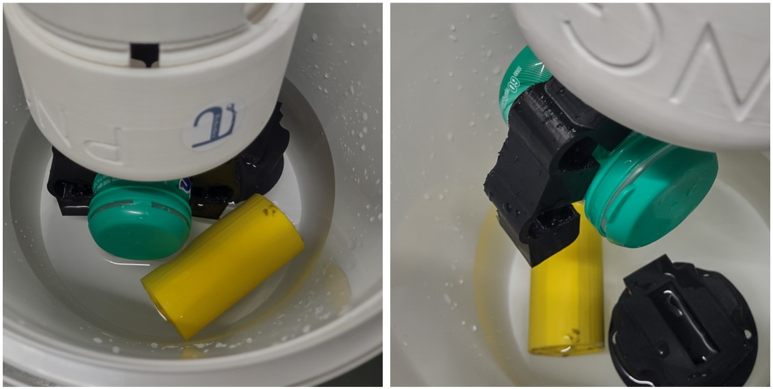
Mechanical Characteristics Analysis
Several tests were conducted:
  Fatigue testing: 10,000 grasping cycles
  Durability testing: resistant to hammer strikes, plier pinches and rough handling.
  Capability to handle objects in liquids.

Slide 25
Conclusions
  PNG hand provides a scalable, low-cost solution for disposable robotic hands
  Experimental results validated the developed model
  The PNG design display great grasping results with 2,3 and 4 fingers
  Wide range of scaling (350% and more)
  Customized Software enable easy operation and integration
  Neural Network Assistance enable precise control and validated the model
  The versatile and robust design sets a new standard for one shot 3D printed gripper
  The low-cost nature of the PNG will allow it to integrate in a variety of fields

